Slide 1
Linked Data
Semantic Web
1st semester 2018-2019
Lecture #5

Slide 2
Data
Information (data, knowledge) becoming huge (in size and dimension), globally distributed (by location), heterogeneous (by nature of the source), dynamic (changing with space-time and other contexts) and multi-disciplinary (by scope).

Slide 3
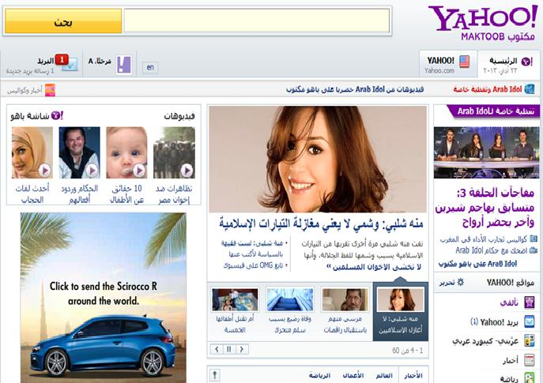
Web Page

Slide 4
Web Pages

Slide 5
Understands The Page Contents
Say What ?

Slide 6
Web of Decuments
Single Global Information Space
URLs as
globally unique IDs
retrieval mechanism
HTML as shared content format
Hyperlinks
Web Browsers
Search Engines
HTML
HTML
HTML
hyper- links
A
B
C

Slide 7
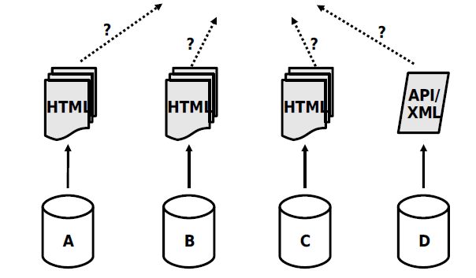
How do we know these documents about Basarh

Slide 8
Problem
As Web content is only loosely structured it is difficult for applications to do smart things with it.
Solution
Increase the structure of Web content.

Slide 9
Each document contains different number of things
The solution
Disconnected Data
Represent data in a way understandable by computer

Slide 10
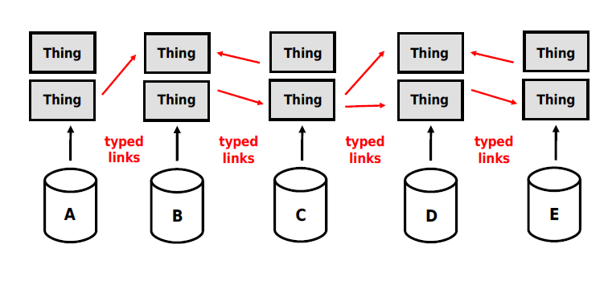
Linked Data
Use Semantic Web technologies to
publish structured data on the Web,
set links between data from one data source to data within other data sources.

Slide 11
Linked Data Principles
1. Use URIs as names for things
2. Use HTTP URIs so that people can look up those names
3. When someone looks up a URI, provide useful RDF information
4. Include RDF statements that link to other URIs so that they can discover related things
Tim Berners-Lee 2007
http://www.w3.org/DesignIssues/LinkedData.html

Slide 12
The RDF Data Model
pd:cygri
rdf:type
foaf:Person
foaf:name
Richard Cyganiak
foaf:based_near
dbpedia:Berlin
Notes:
Todo: Animation einfügen
Namespaces erklären
Retrieval erklären
RDF graph erklären

Slide 13
Data objects are identified with HTTP URIs
pd:cygri
rdf:type
foaf:Person
foaf:name
Richard Cyganiak
foaf:based_near
dbpedia:Berlin
pd:cygri = http://richard.cyganiak.de/foaf.rdf#cygri dbpedia:Berlin = http://dbpedia.org/resource/Berlin
Notes:
Todo: Animation einfügen
Namespaces erklären
Retrieval erklären
RDF graph erklären

Slide 14
Dereferencing URIs over the Web
pd:cygri
rdf:type
foaf:Person
foaf:name
3.405.259
Richard Cyganiak
dp:population
foaf:based_near
dbpedia:Berlin
skos:subject
dp:Cities_in_Germany
Notes:
Todo: Animation einfügen
Namespaces erklären
Retrieval erklären
RDF graph erklären

Slide 15
Dereferencing URIs over the Web
pd:cygri
rdf:type
foaf:Person
foaf:name
3.405.259
Richard Cyganiak
dp:population
foaf:based_near
dbpedia:Berlin
skos:subject
dbpedia:Hamburg
skos:subject
dp:Cities_in_Germany
dbpedia:Muenchen
skos:subject
Notes:
Todo: Animation einfügen
Namespaces erklären
Retrieval erklären
RDF graph erklären

Slide 16
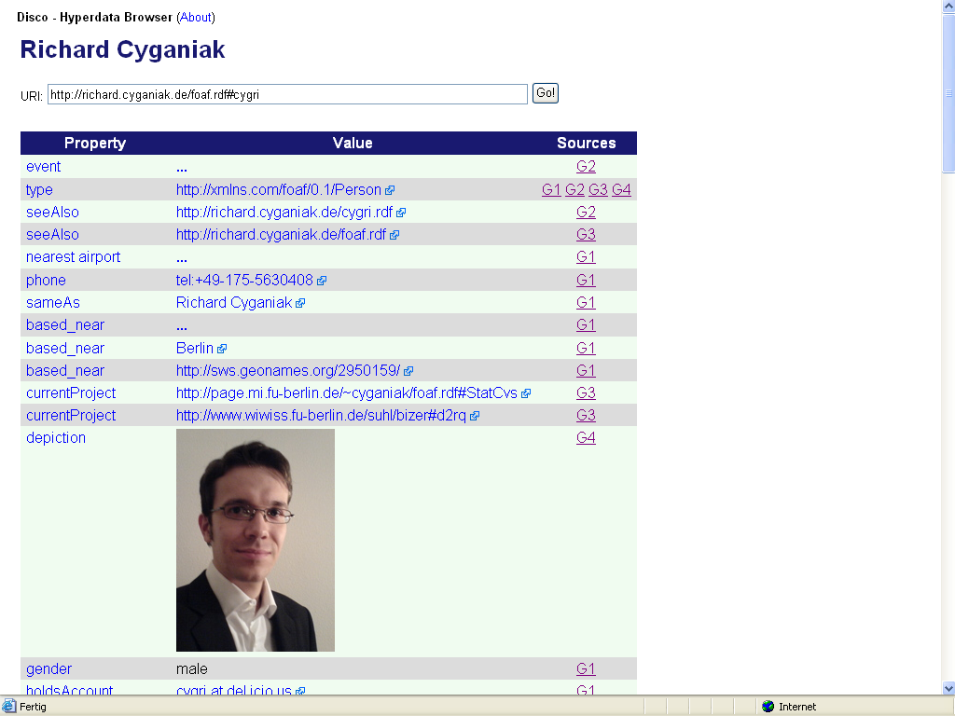
The Disco – Hyperdata Browser

Slide 17
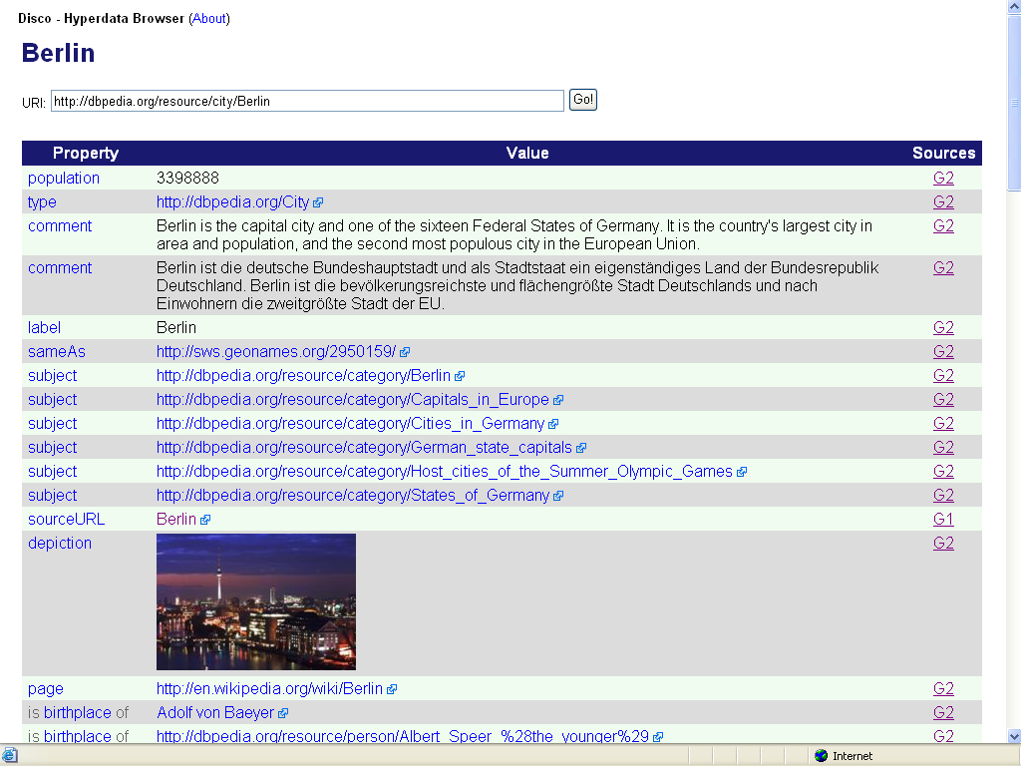

Slide 18
Linking Data Resources
RDF
User
Query & results
Data
Ontologies
Structured & Unstructured Data Sources

Slide 19
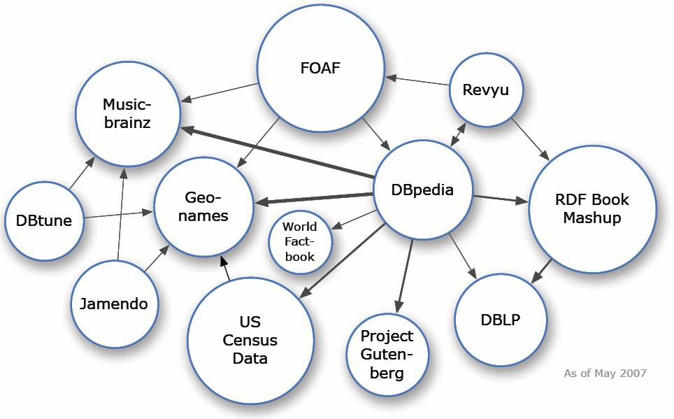
LOD Datasets on the Web: May 2007
 Over 500 million RDF triples
 Around 120,000 RDF links between data sources

Slide 20
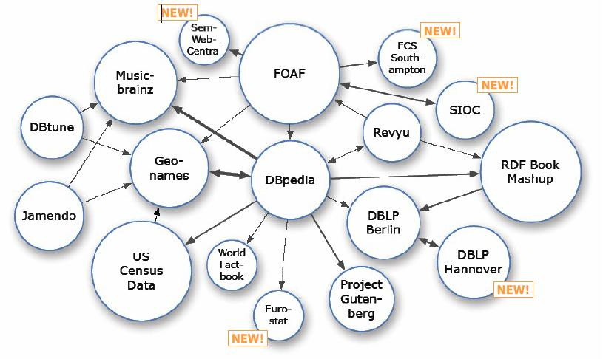
LOD Datasets on the Web: July 2007
NEW

Slide 21
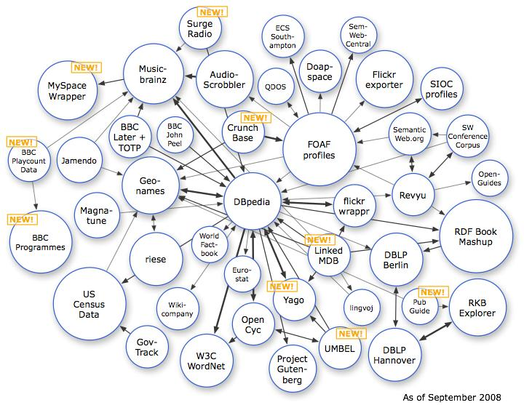
LOD Datasets on the Web: September 2008

Slide 22
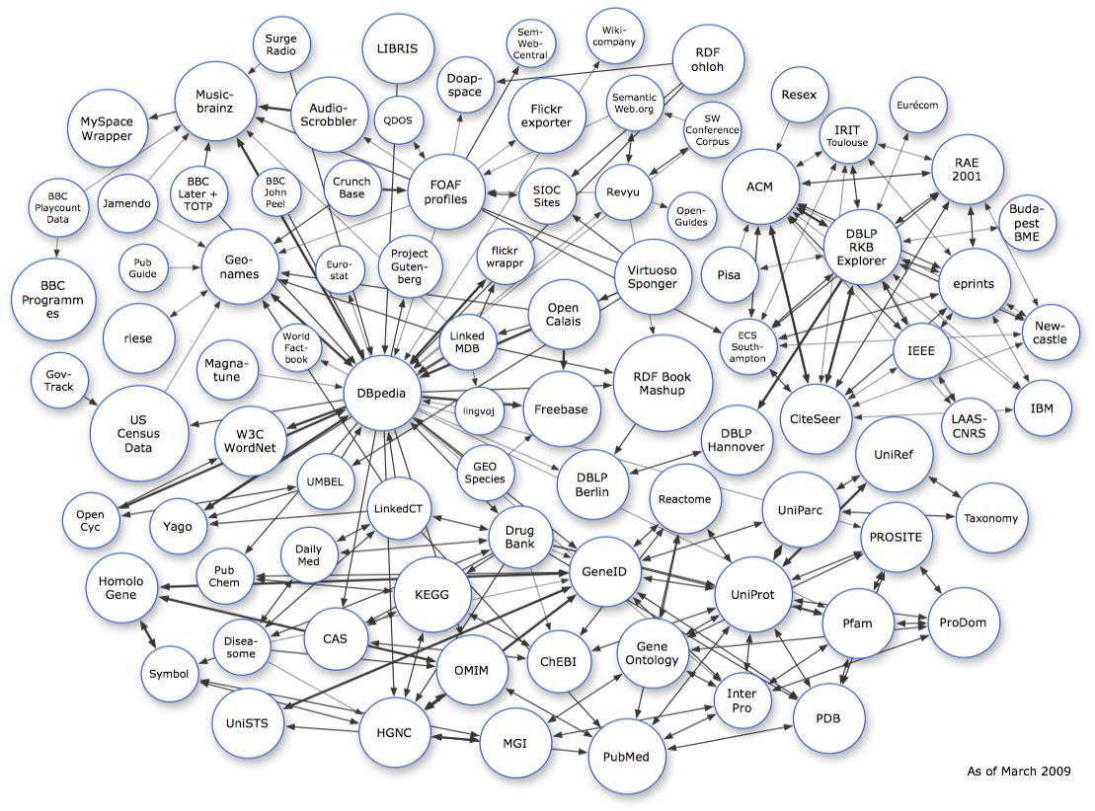
LOD Datasets on the Web: March 2009

Slide 23
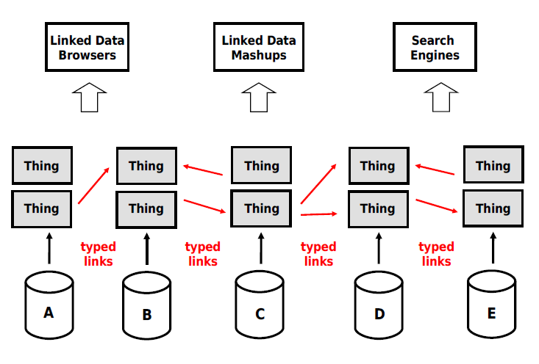
So what can we do with this?

Slide 24
Properties of the Web of Linked Data
Anyone can publish data to the Web of Linked Data
Entities are connected by links
creating a global data graph that spans data sources and enables the discovery of new data sources.
Data is self-describing
If an application encounters data represented using an unfamiliar vocabulary, the application can resolve the URIs that identify vocabulary terms in order to find their RDFS or OWL definition.
The Web of Data is open
meaning that applications can discover new data sources at run-time by following links.

